Slide 1
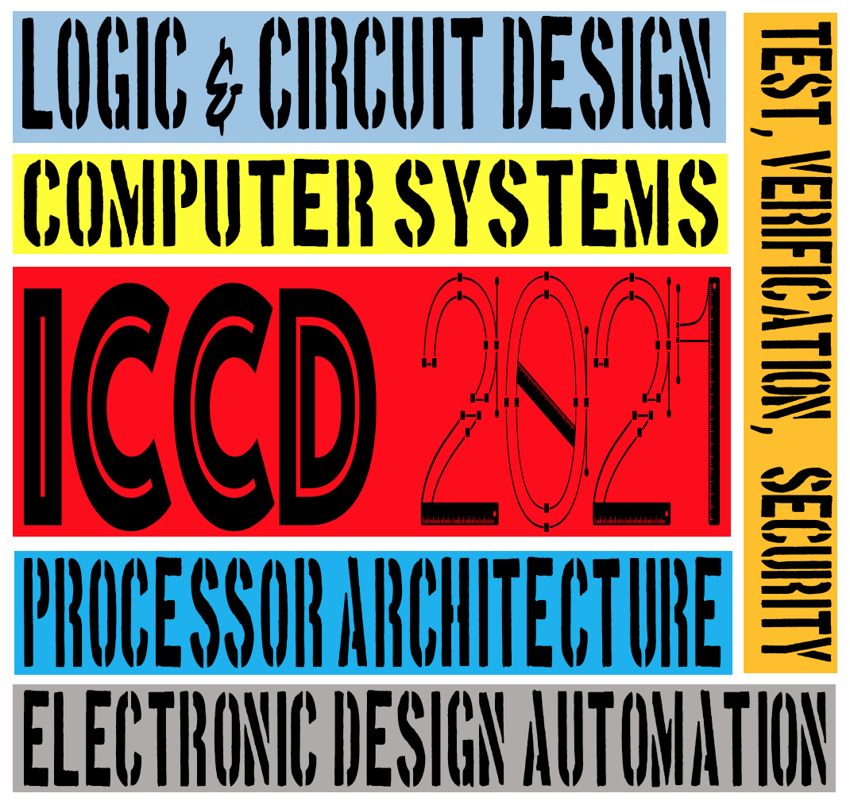



Comprehensive Failure Analysis against Soft Errors from Hardware and Software Perspectives
Paper 68
Yohan Ko*, Jinhyo Jung*, Hwisoo So*, Kyoungwoo Lee*, Aviral Shrivastava# *Yonsei University, South Korea #Arizona State University, United States Presented by Jinhyo Jung

Slide 2
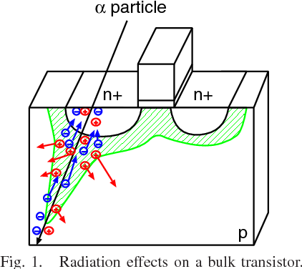
Soft Errors: main threats to reliability
Soft errors undermine system reliability
Soft errors cause real-world problems
Sun Microsystems server crash, 2000
Qantas Flight 72 inflight accident, 2008
0 | 1 | 0 | 1
0 | 1 | 0 | 0
Image from J. Fruta et al. "Analysis of neutron-induced soft error rates on 28nm FD-SOI and 22nm FinFET latches by the PHITS-TCAD simulation system." 2017 International Conference on Simulation of Semiconductor Processes and Devices (SISPAD). IEEE, 2017.

Slide 3


Protection Techniques
Full Protection
Undesirable due to high costs
Selective Protection
Protect only critical regions
Which parts of the system are most vulnerable to soft errors?

Slide 4
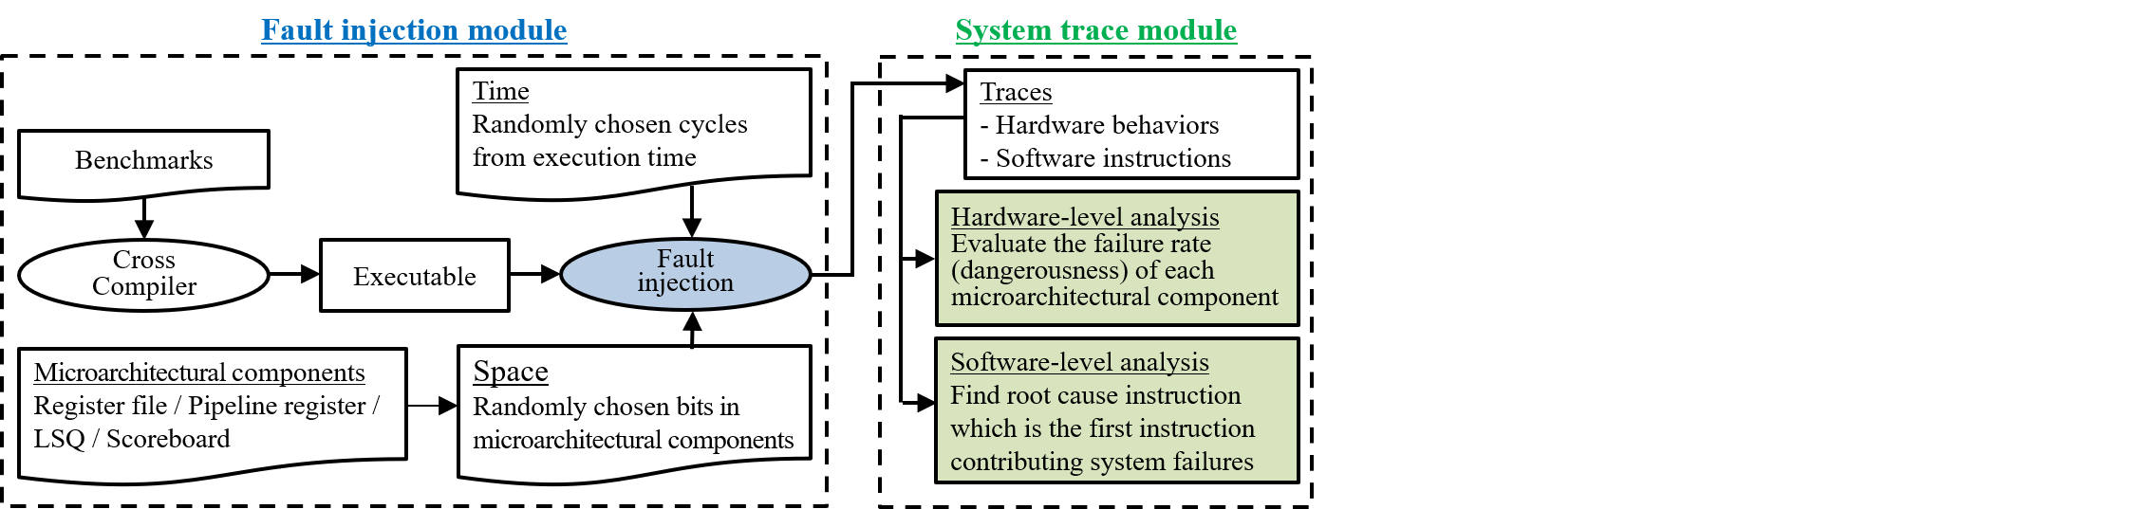
Failure Analysis Framework
Failure analysis framework based on gem5 ^{[Binkert, SIGARCH} ^{‘11]}
Inject faults and analyze system failures
Hardware perspectives
Software perspectives

Slide 5
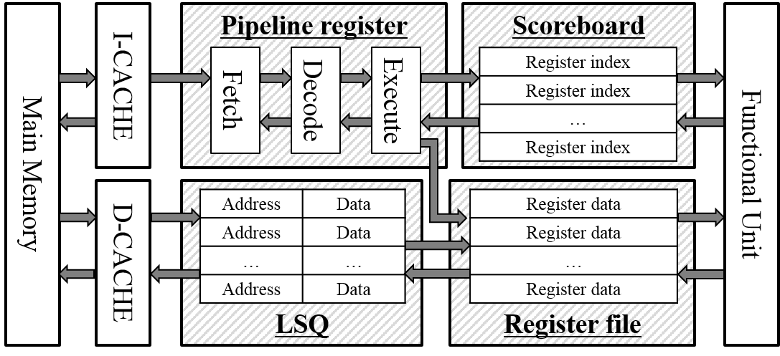
Hardware-perspective Analysis
Inject faults in each of the four components to calculate component-wise vulnerability

Slide 6
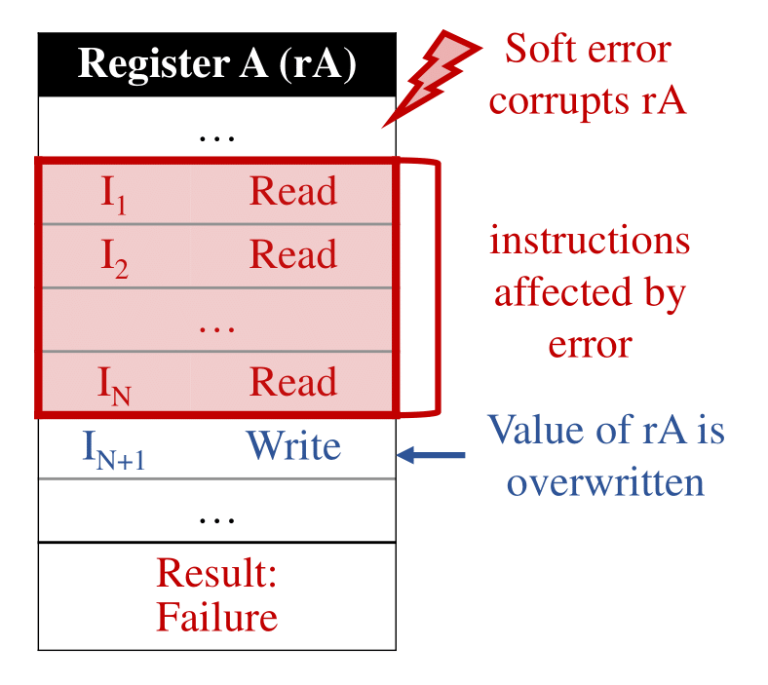
Software-perspective Analysis
Need to map hardware-injected faults to software instructions
Root cause instruction analysis
Two-step analysis to find instruction responsible for system failure
Step 1: Find all instructions that read corrupted data

Slide 7
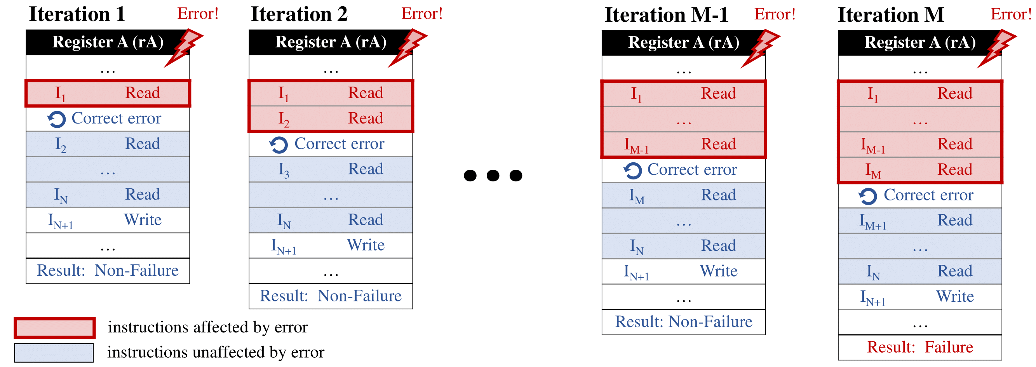
Software-perspective Analysis
Step 2: Isolate the effect of injected fault to a single instruction
Iterate step 2 until root cause instruction is found

Slide 8
Comprehensive Analysis Results
Failure Rates of Hardware Components
Pipeline registers most vulnerable
Failure Distribution of Software Instructions
Load instructions most vulnerable
Pipeline Register | Load Store Queue | Register File | Scoreboard
63.5% | 31.3% | 40.6% | 5.4%
Branch | Cmp | Logical | Arthm | Load | Store
4.6% | 4.0% | 4.0% | 25.4% | 37.9% | 24.1%

Slide 9
Comprehensive Analysis Results
Failure rate drops from 34.34% to 12.40%

Slide 10
Summary
Selective protection techniques require knowledge of the most vulnerable parts of the system
Comprehensive failure analysis framework to identify most vulnerable hardware component and software instruction type
Protecting pipeline registers and load instructions reduces failure rate by 60%

